Slide 1
Questions
What are the objectives of ATFM?
What are the main causes of air traffic congestion ?
What are the functions of ATFM ?
What are the three phases of ATFM ?
What is the concept of capacity ?
What are the ways to maximize en route capacity ?
What are the methods for the assessment of airspace capacity ?
What are the methods for the assessment of airport capacity ?

Slide 2
The objective of air traffic flow & Capacity management
To ensure an optimum flow of air traffic to or through areas during times when demand exceeds, or is expected to exceed, available capacity of the air traffic control (ATC) system.

Slide 3
The main causes of the air traffic congestion
accumulation of air traffic during specific periods of the year and also during certain times of the week and hours of the day, due to holiday patterns and travel habits of the public;
differences in the capacities of the various ATC systems or parts of these systems affected by traffic accumulations;
insufficient advance notice (to ATC units) of likely traffic demands which may cause overloading of the system at certain points, in certain areas, and/or during specific time periods;
lack of proven techniques and procedures to restore, in critical situations, a reasonable balance between traffic demand and available ATC capacity by means acceptable to aircraft operators both from an operational and from an economic point of view.
Notes:
1.特定时间段任务集中导致拥堵
2.不同ATC或ATC组成部分受拥堵情况影响不同
3.对于可能造成系统超载的交通需求预判不足
4.由于需要考虑实际操作和经济性的因素，导致技术和装备不能满足要求

Slide 4
The functions of ATFCM
collection and collation（核对） of data on the air navigation infrastructure and on the capacities of the ATC system and selected aerodromes within the area, including runway, taxiway and gates capacities. This embraces those areas in which traffic flow problems are likely to be encountered;
collection and analysis of data for all planned controlled flight operations into, out of, within and through the area;
determination of a coherent picture of expected traffic demand, including anticipated ad hoc traffic, comparison with available capacity and identification of areas and time periods of expected critical traffic loadings;
co-ordination with the appropriate ATS authorities in order to make every possible attempt to increase the available ATC capacity where required. In some particular situations it could be advantageous for national and local scheduling committees to be established, with representatives from national ATS, airport authorities, national and international operators. Such committees can make significant contributions when developing strategies to reduce the impact of peak demand periods; and where ATC capacity shortfalls cannot be eliminated, determination and implementation in good time of suitable tactical measures coordinated throughout the area as necessary and with aircraft/aerodrome operators concerned.
Notes:
1.在易于发生拥堵的区域收集并核对空中导航，ATC容量及机场的相关信息
2.收集并分析计划进入，驶出，在内或者通过该区域的飞机的信息
3.匹配收集的空域和飞机的信息制定可行计划
4.与ATS部门协调增加ATC容量

Slide 5
The three phases of ATFCM
1 year
1 week
Real-time
Traffic Forecast
Strategic Flow & Capacity Planning
Real-Time Operations
ATC
ASM
Airport
AOs
Establishment of scenarios and harmonized planning considering:
Traffic Demand
Airspace Structure
ATC Capabilities
Airport Capabilities
Optimized Capacity Management
Pro-active optimization of the Network Operations Plan and anticipation of events in order to maintain the network stability
Tactical Flow&
Capacity Management
Monitoring of the ATFCM situation and reaction to real-time events to minimize disruption impact and/or to take benefit of opportunities
Resources
Airspace
ATC
Airport
Feedback
Feedback
Feedback
Feedback
Planning
Execution

Slide 6
Working Process for Strategic ATFCM
CDM
ASM/ATSPs/Airport/AOs/FMD
Consider the following elements
Reduction of Traffic Demand in critical areas
AO Traffic Forecast
Maximize Network Capacity
Re-routing Flows/Flights
Other capacity
Provision of data required to conduct Pre-tactical Activities
(e.g. RAD. Environment Database, Daily Capacity Plans, etc)
Identify the sectors/airports concerned
Airport Capacity
ATM Environment
Pre-validation of scenarios and airspace structure before any publication (AIP, RAD, etc)
ASM
Airspace Structure
(routes, sectors, etc) including capacity values
Holding Patterns
Arr/Dep
Capacity
Define Scenarios/Modus Operandi (routes, areas, sectors)
NO
YES
Pre-tactical & Tactical Working Processes
Are
There Capacity shortfalls?
En-route Capacity
Are
There Capacity shortfalls?
NO
Reduce Traffic Complexity
Increase Capacity Value
FL management
ATC
Capabilities
(Staff resources, operating techniques, system support)
YES
YES
Adapt the Sector Configuration
Acceptable but requiring Pre-tactical and/or Tactical fine-tuning
Airport
Capabilities
(Schedule, infrastructure, etc)
Adapt the Number of Sectors
Civil/Military Coordination
Request for Changes & Feedback
Feedback

Slide 7
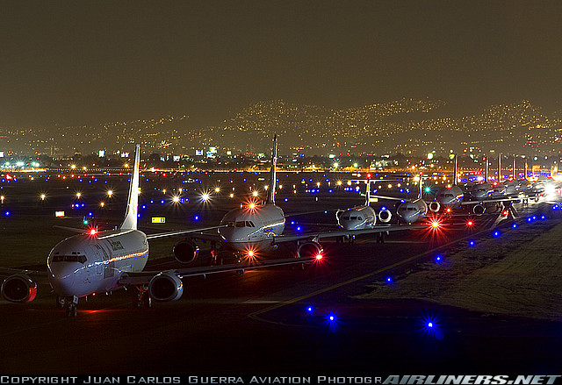
Airport Capacity Assessment
airport capacity is the maximum number of airport operations in a given aerodrome under specified conditions (e.g., aerodrome layout, aircraft mix, weather conditions, facilities, aircraft parking, etc.),
taking into account all
take-off and landing
operations during a
specified period of time
(hour, day, month,
year, season).

Slide 8
Methodologies to Assess Airport Capacity
Analytic models
Time-space analysis
Queuing models (deterministic and stochastic)
Simulation-based models
Monte Carlo Simulation
Continuous simulation models
Discrete-event simulation models

